Slide 1
Undefined Behaviour
Advanced Compiler Techniques
Source: https://www.youtube.com/playlist?list=PLf3ZkSCyj1tf3rPAkOKY5hUzDrDoekAc7
Videos: 166 - 170

Slide 2
Module 166
Undefined Behaviour Semantics

Slide 3
What is undefined behaviour?
For some statements (for instance divide by 0), the behaviour is not logically well defined.
The language designer may choose to define this behaviour (for example, in languages such as Java and Python, an exception may be generated), or they may choose to leave it undefined (for example, C/C++).

Slide 4
What happens if is such behaviour is left undefined?
The code may behave differently on different machines.
The exact implementation decides what will happen. The language provides no guarantees about the behaviour.
Example: The compiler may leave it up to the assembler to handle the undefined behaviour.
Example: The hardware may crash the machine if such behaviour is triggered.
Example: The hardware may simply ignore such instructions (effectively replacing the instruction by a nop)

Slide 5
Cost of handling undefined behaviour
Consider an illegal memory access (for instance, due to an out of range index).
The language may choose to define such behaviour by adding explicit checks and throwing exceptions if they fail. Such checks will add 3-4 instructions to the code for every access.
Some other languages may say that such cost is not justified as the programmer's are not likely to make such mistakes.
Allowing undefined behaviour may lead to security vulnerabilities.

Slide 6
Exploiting UB: Overflows
Is this legal? (Hint: Think about overflows)
int n = ...;
for(int i = 0; i < n+1; i++)
// Some code
int n = ...;
for(int i = 0; i <= n; i++)
// Some code

Slide 7
Exploiting UB: Overflows
What if n = INT_MAX and we have wrap around semantics?
In such a case, the transformation is illegal as both the pieces of code do different things.
int n = ...;
for(int i = 0; i < INT_MAX+1; i++)
// Some code
int n = ...;
for(int i = 0; i <= INT_MAX; i++)
// Some code

Slide 8
Exploiting UB: Overflows
What if signed overflow was UB?
In this case, this is a perfectly legal transformation as the compiler no longer specifies the correct behaviour.
UB allows for optimizations!
int n = ...;
for(int i = 0; i < n+1; i++)
// Some code
int n = ...;
for(int i = 0; i <= n; i++)
// Some code

Slide 9
Exploiting UB: Type Aliasing
Legal? What if b[i] aliases with a?
void foo(int *a, float *b)
{
for(int i = 0; i < N; i++)
b[i] = *a;
}
void foo(int *a, float *b)
{
int local_a = *a;
for(int i = 0; i < N; i++)
b[i] = local_a;
}

Slide 10
Exploiting UB: Type Aliasing
Legal if we assume type based strict aliasing.
void foo(int *a, float *b)
{
for(int i = 0; i < N; i++)
b[i] = *a;
}
void foo(int *a, float *b)
{
int local_a = *a;
for(int i = 0; i < N; i++)
b[i] = local_a;
}

Slide 11
Exploiting UB: Based Variables
Legal? What if n >= 257 and A[256] aliases with B[0]?
int A[256];
int B[1];
void foo(int n)
{
int *p = A;
for(int i = 0; i < n; i++, p++)
*p += b[0];
}
int A[256];
int B[1];
void foo(int n)
{
int *p = A;
int local_b = b[0];
for(int i = 0; i < n; i++, p++)
*p += local_b;
}

Slide 12
Exploiting UB: Based Variables
Legal if p is based on A, i.e. p never goes out of A’s allocated memory region.
int A[256];
int B[1];
void foo(int n)
{
int *p = A;
for(int i = 0; i < n; i++, p++)
*p += b[0];
}
int A[256];
int B[1];
void foo(int n)
{
int *p = A;
int local_b = b[0];
for(int i = 0; i < n; i++, p++)
*p += local_b;
}

Slide 13
UB in IR
Signed overflows in LLVM are UB.
If the source language is not C/C++, the frontend will add explicit checks in IR while generating code.
Some instructions can have multiple flavours to handle different UB semantics.
x = add y, z
x = add nsw y, z // UB if signed overflow
x = add nuw y, z // UB if unsigned overflow

Slide 14
Module 167
Undefined Behaviour in IR

Slide 15
UB in source and target
UB in a source usually provides opportunities for optimizations.
UB in target may cause issues as from the correctness perspective, the compiler cannot add more non-determinism.

Slide 16
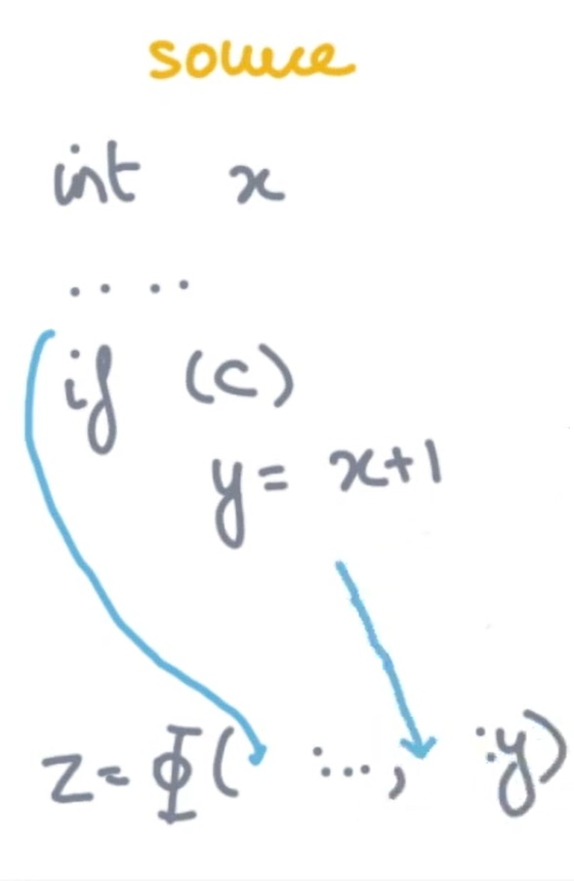
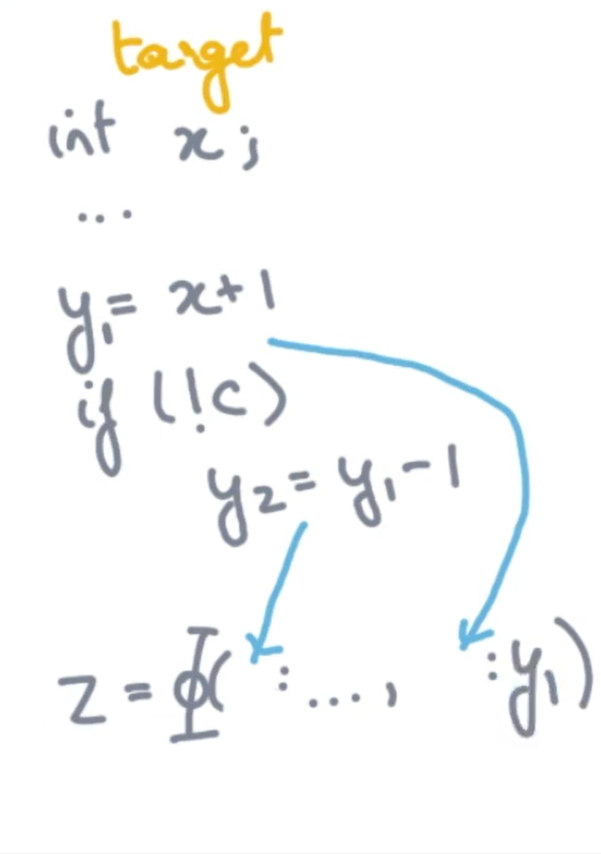
When does UB reduce optimization opportunities?
Valid?

Slide 17
When does UB reduce optimization opportunities?
What if x = INT_MAX and overflow is UB? If c = false, left never triggers UB but right always does.

Slide 18
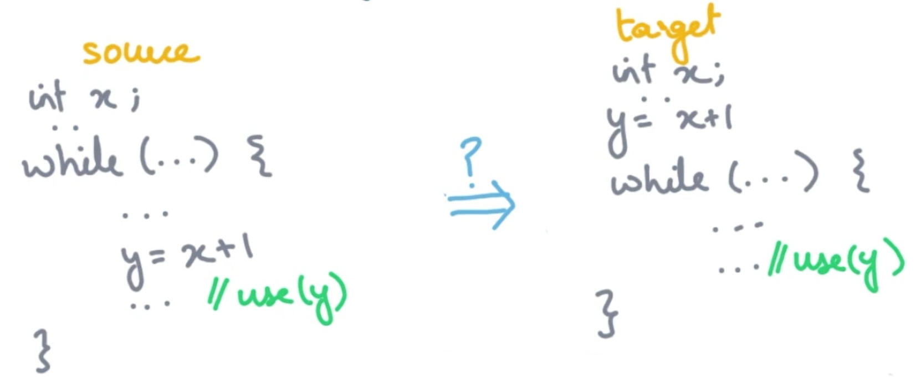
UB may limit optimizations

Slide 19
UB may limit optimizations
Invalid as right always triggers UB, whereas left only triggers UB is while’s condition is true

Slide 20
UB in source and target
UB in source enables optimizations.
UB in targets hinders optimizations.
Ideally, the source has lots of UB and the target has no UB.
IR designer has to find a middle ground.

Slide 21
Module 168
Poison Values

Slide 22
What are poison value semantics?
If a program as UB, anything can happen.
Out all such possibilities, we pick the possibility of generating an error. This is called a poison value.
Example: If x = a + b and the addition overflows, instead of classifying this statement as UB, we simply assign an error variable to x.

Slide 23
How does poison value help?
In this case, y is assigned a poison value. Since y is never used again, this is a valid transformation

Slide 24
How does poison value help?
Under poison value overflow semantics, this is a valid transformation. If c is false, then the target never uses y₁.

Slide 25
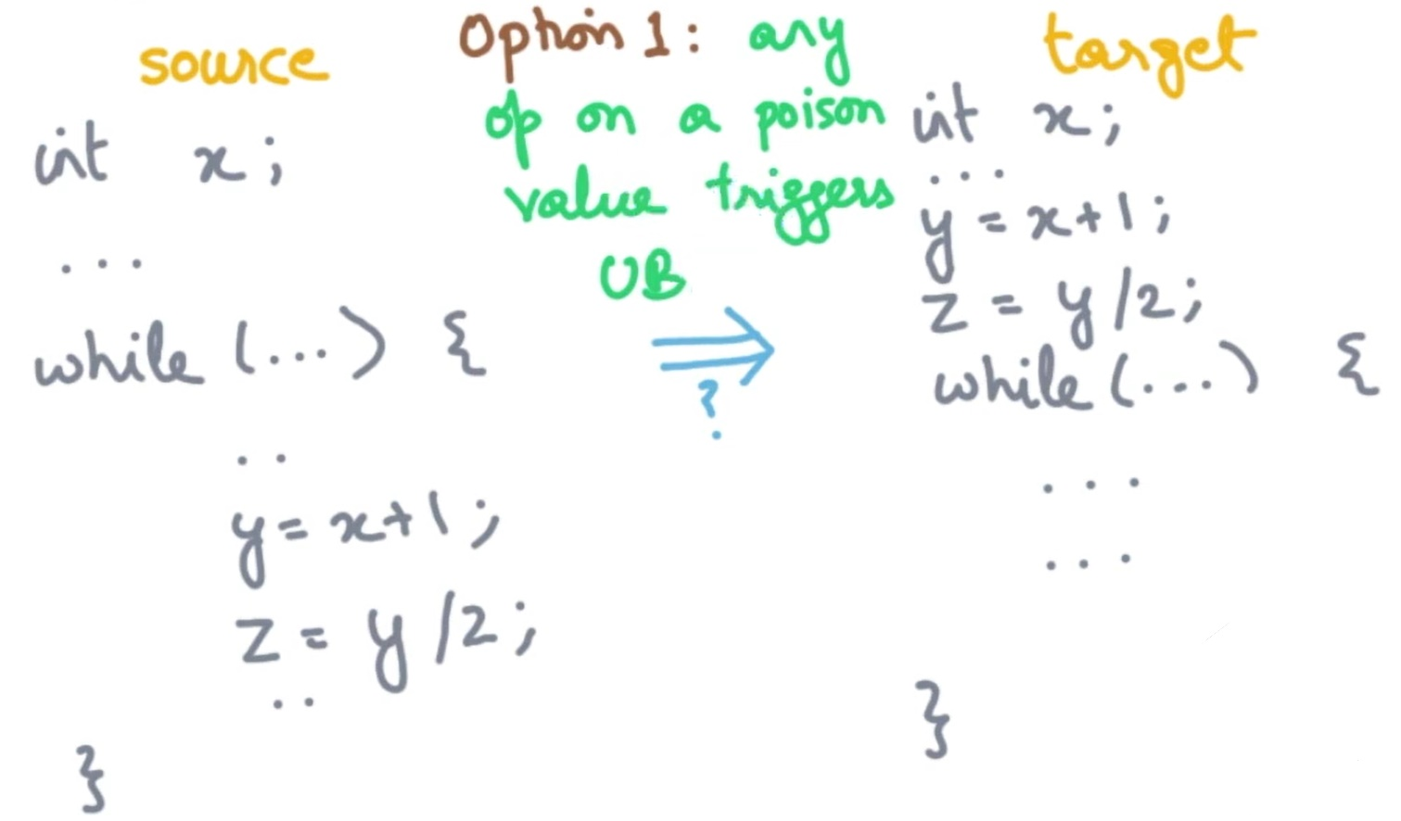
Operations on poison value
Legal?

Slide 26
Operations on poison value: Option 1
No!
z = y/2 triggers UB

Slide 27
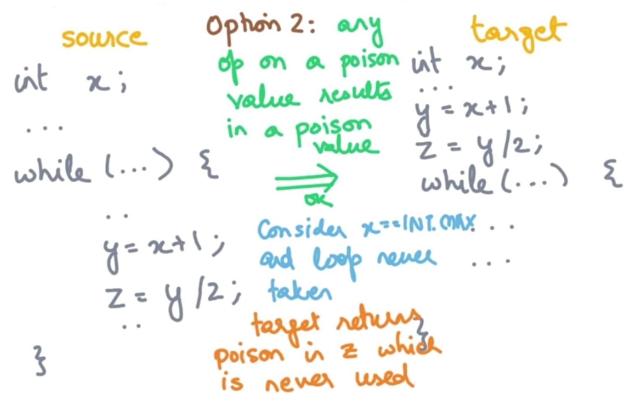
Operations on poison value: Option 2

Slide 28
Operations on poison value
Option 2 is preferable as it allows for more optimizations.
(x₁ op x₂) may generate a poison value if any of the arguments is a poison value. A poisoned value poisons the rest of the computation.

Slide 29
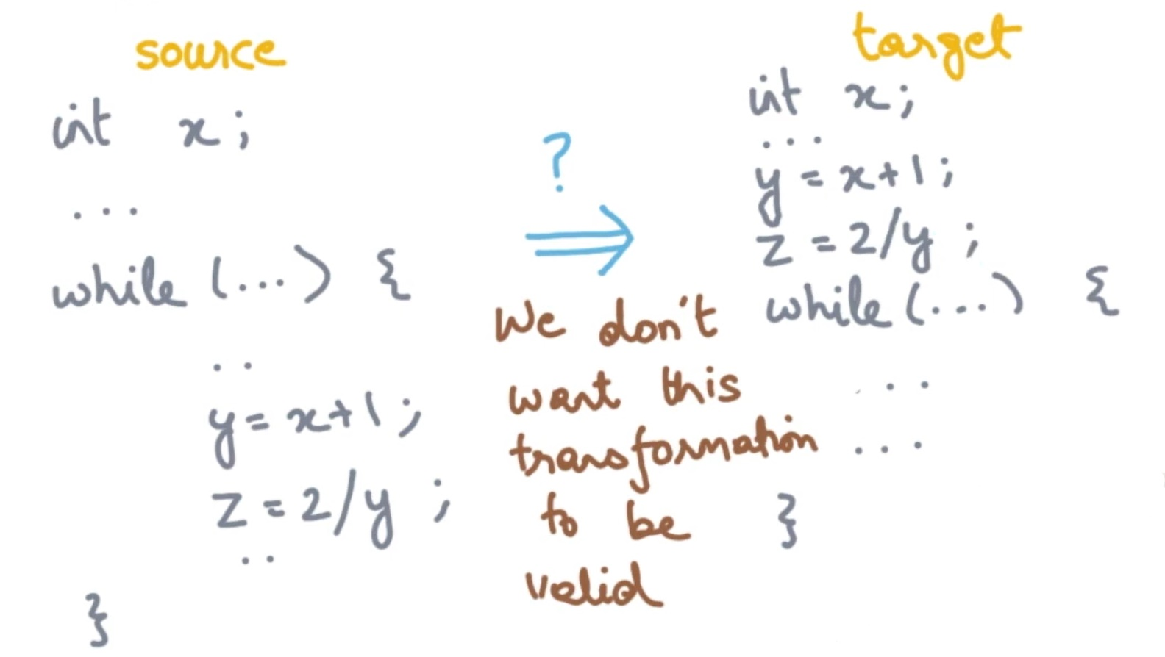
Should we allow this transformation?
What if the hardware is designed to terminate the program on divide-by-zero? In this case the target will always get terminated. Such a transform is NOT sound.

Slide 30
Why did this happen?
Divide by zero is more dangerous than other transforms. If we hoist the computation out of the loop, the program will surely terminate (due to hardware semantics).
Therefore in some cases, operations on poison values can result in UB.
Ops which trigger dangerous behaviour (such as termination) should trigger UB.
Ops which don’t generate dangerous behaviour (they may merely result in incorrect computation), should return poison values.

Slide 31
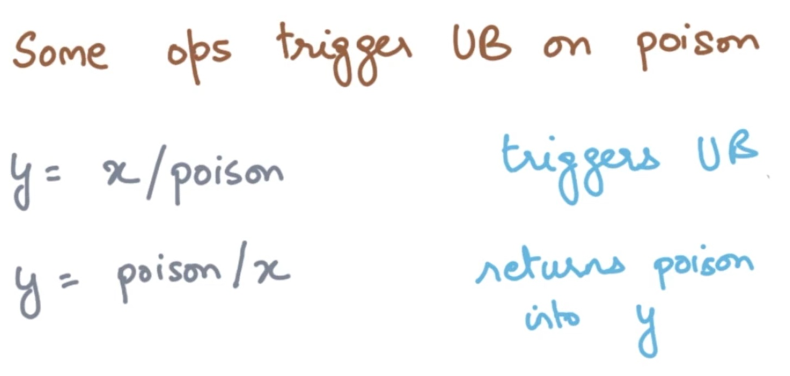
Poison value semantics

Slide 32
Module 169
Poison Value Operational Semantics

Slide 33
Guiding Principle
If a poison value exists, then the original program had UB. Therefore any choice is valid from the correctness point of view.
However, we want to choose a behaviour which maximize optimization opportunities.

Slide 34
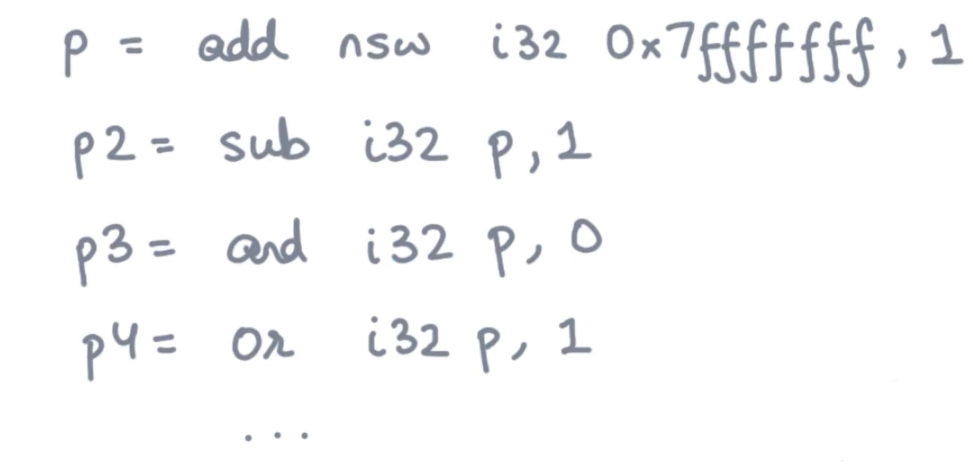
Poison Value Semantics

Slide 35
Poison Value Semantics
All of these return poison values.
ANDing poison with 0 could have been defined as 0. However, a poison value is more general than 0. Moreover, a poison value can always be converted to 0.
Poison value is more flexible.
As long as the operation does not generate a dangerous behaviour, returning a poison value maximizes optimization opportunities.

Slide 36
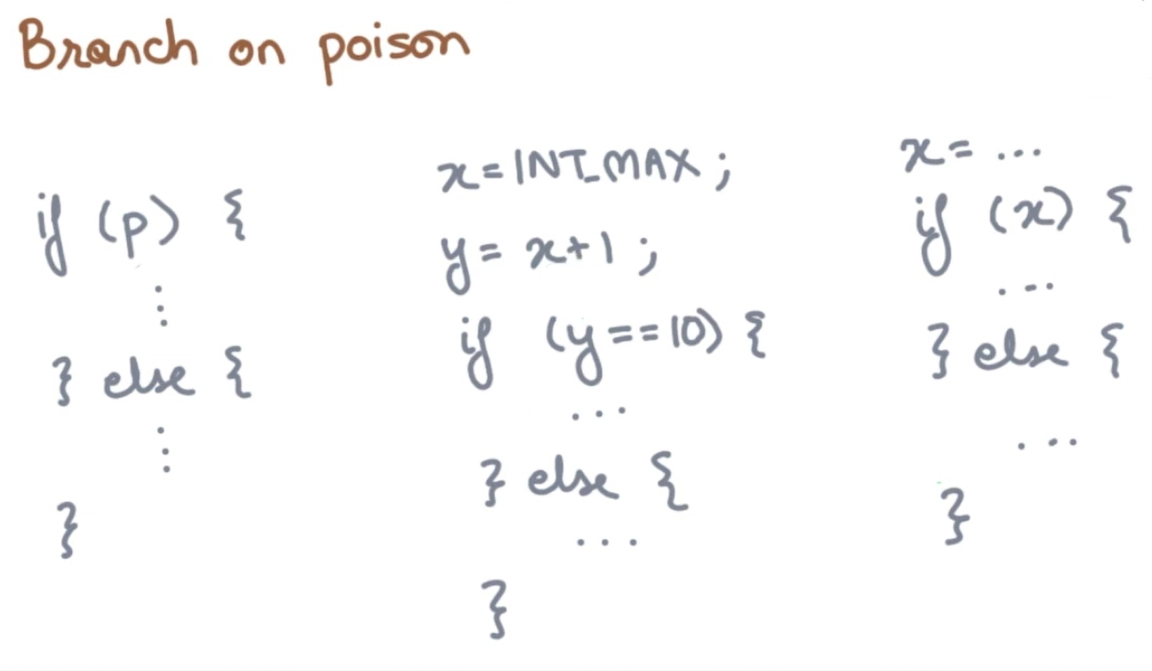
Branch semantics in the presence of poison values

Slide 37
Branch semantics in the presence of poison values
We can non-deterministically choose one of the branch. However, this can make the rest of the analysis difficult.
We can make every instruction in both the branches nops. This may not always make logical sense.
We may use information from other passes (if available) to make a decision. Example: if the compiler can prove that x is either 0 or poison, then always picking the else branch may be optimal.
There is no clear choice. Hence, LLVM defines such cases as UB.

Slide 38
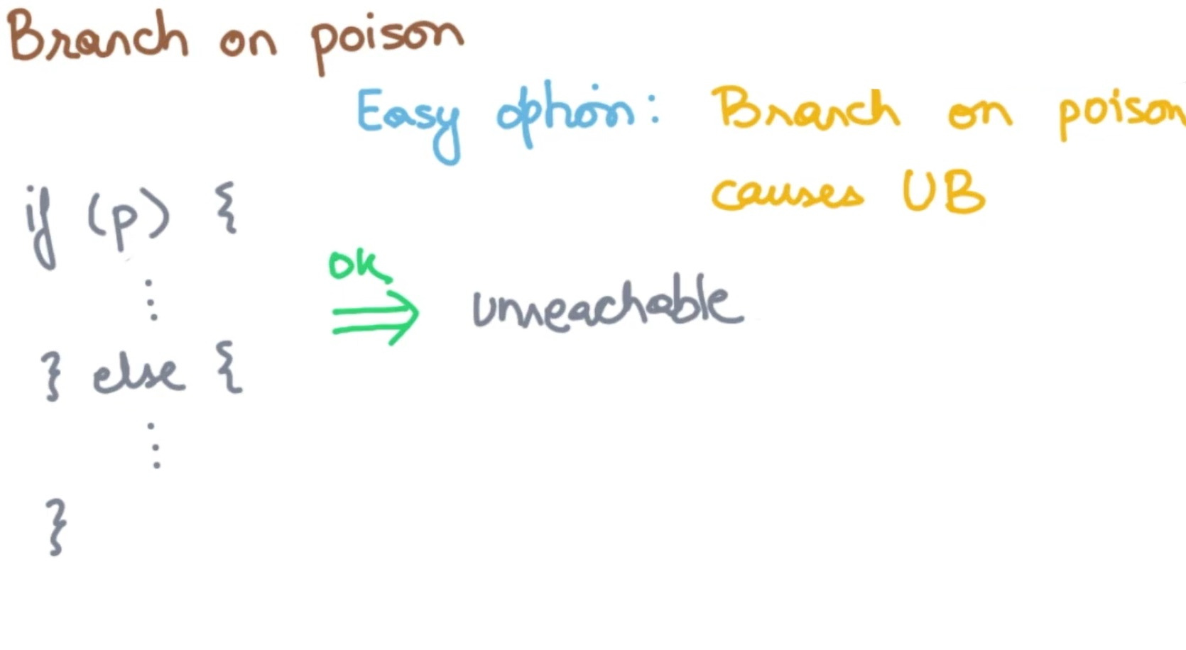
The compiler marks such branches as unreachable

Slide 39
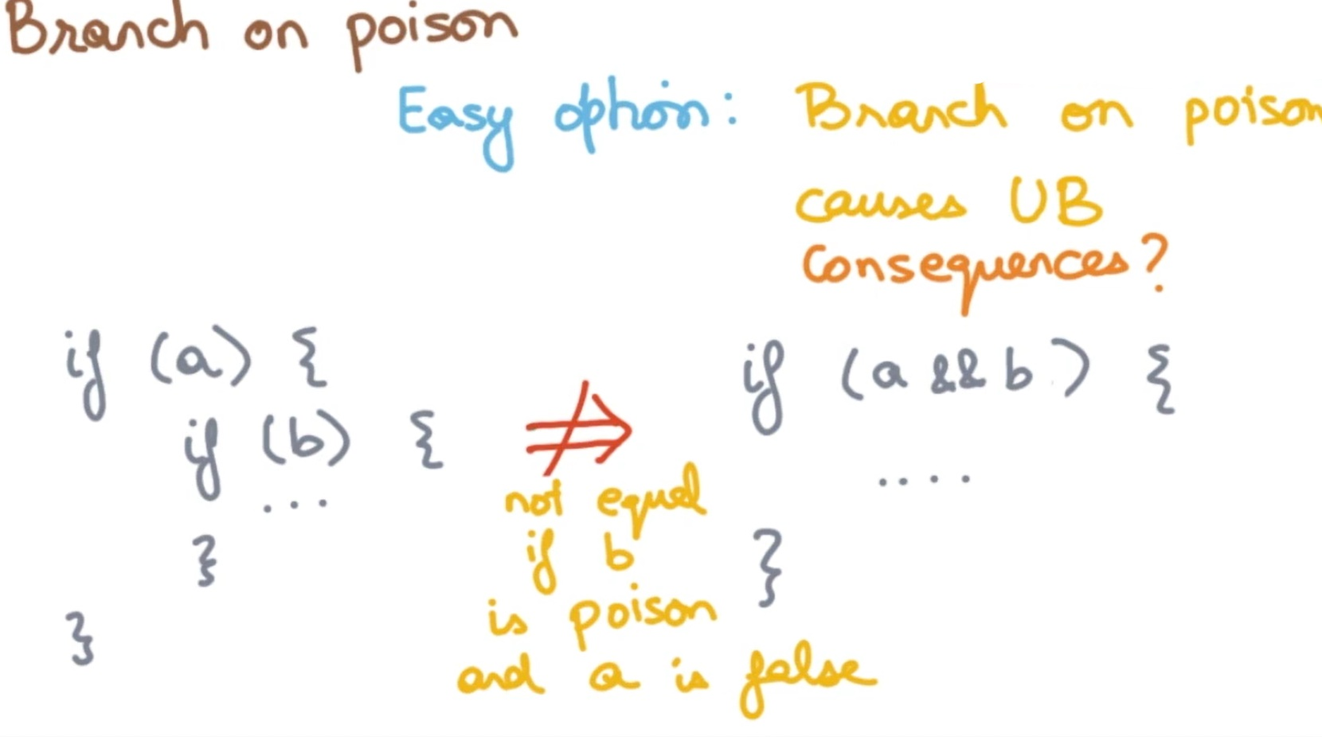
When is this sub-optimal? Example 1

Slide 40
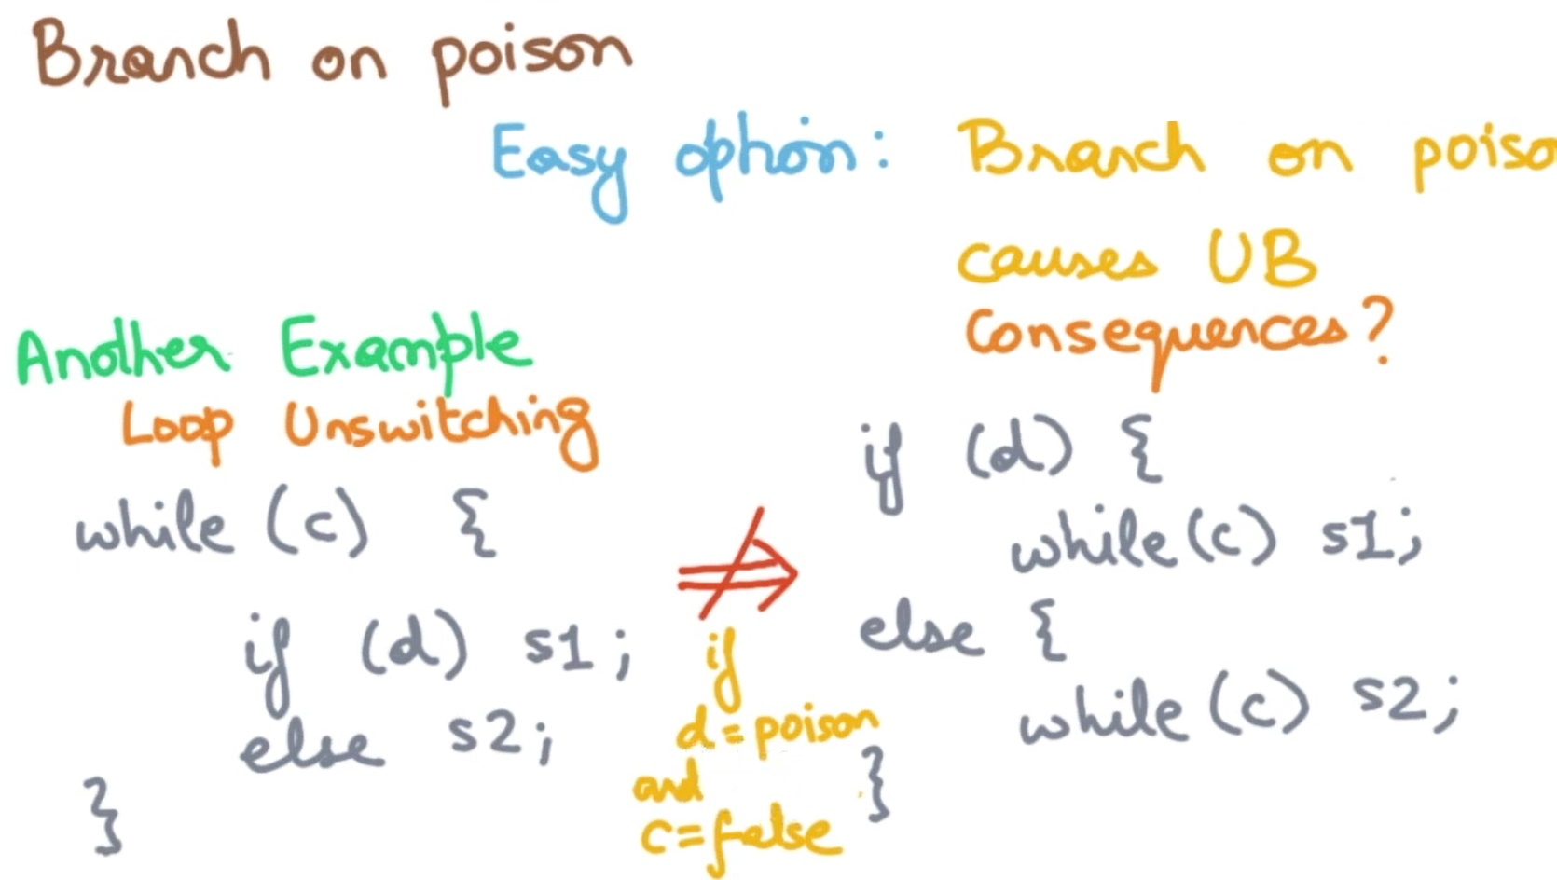
When is this sub-optimal? Example 2

Slide 41
Memory accesses with poison values
If the data is poison but the address is not, then store poison value in the memory. Reading from the same location will then return a poison value.
*x = p; // Store a poison value
y = *x; // y now has a poison value

Slide 42
Memory accesses with poison values
If the address is poison, trigger UB.
*p = x; // UB
y = *p; // UB

Slide 43
Poison values and cost of UB
Everytime we define a poison value operation semantic as UB, we reduce the optimization opportunities.
For example, if an instruction triggers UB, it cannot be hoisted out of the loop.
Some opcodes have constrained motion (for example division by poison), whereas others have unconstrained motion.

Slide 44
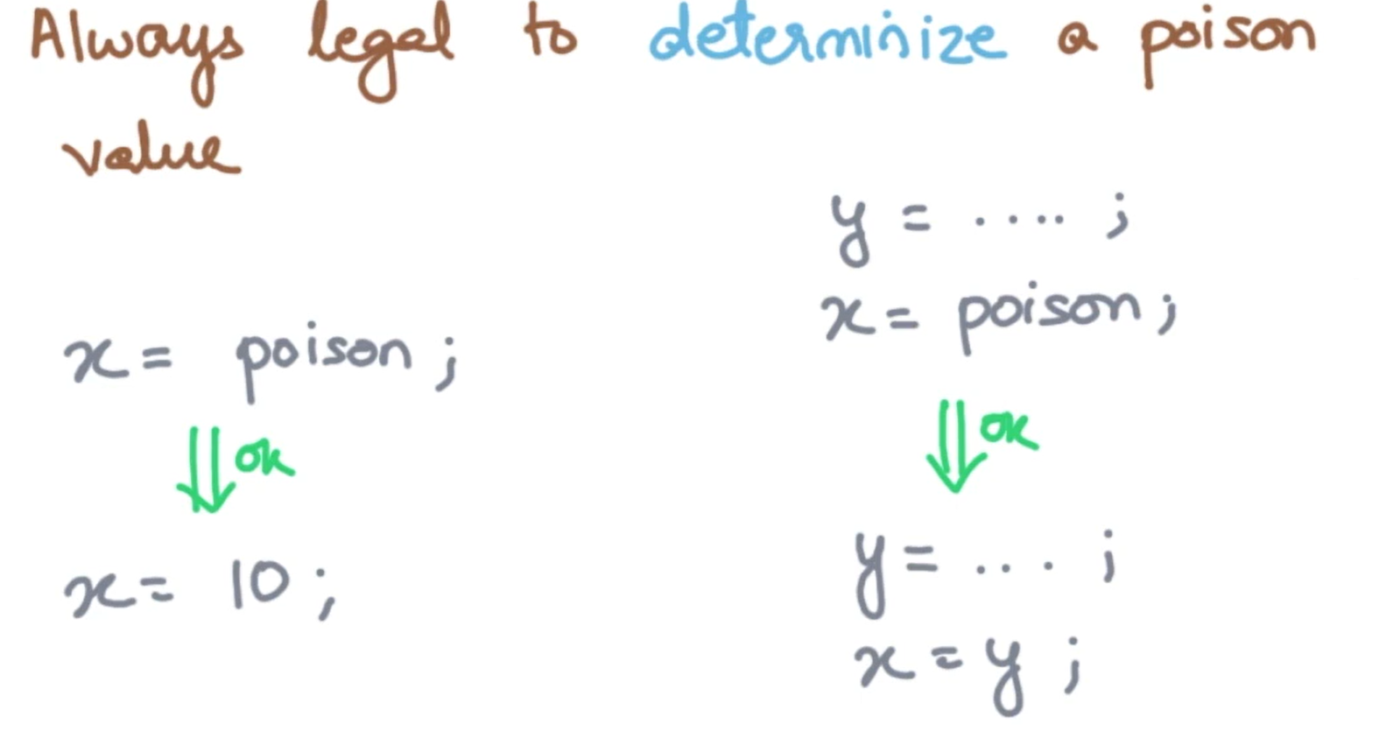
Converting poison values to deterministic values
From a correctness standpoint, it is valid to determinize poison values.
However, it reduces the opportunities for optimizations. Therefore, compiler typically avoid such operations.

Slide 45
Module 170
Immediate v/s Deferred UB

Slide 46
Immediate vs Deferred UB
In some cases LLVM will immediately generate UB, whereas in other cases, it generates a poison value.
Example | C | LLVM
int y = INT_MAX + 1; | Immediate UB | Poison Value
int y = x / 0; | Immediate UB | Immediate UB
int y = x + <poison value>; | - | Poison Value
if(<poison value>) {…} else {...} | Immediate UB | Immediate UB

Slide 47
Immediate vs Deferred UB
If poison value is never used in a dangerous operation, we can avoid UB.
Therefore poison values are a form of deferred UB.

Slide 48
Thanks!
Setu Gupta

